Slide 1
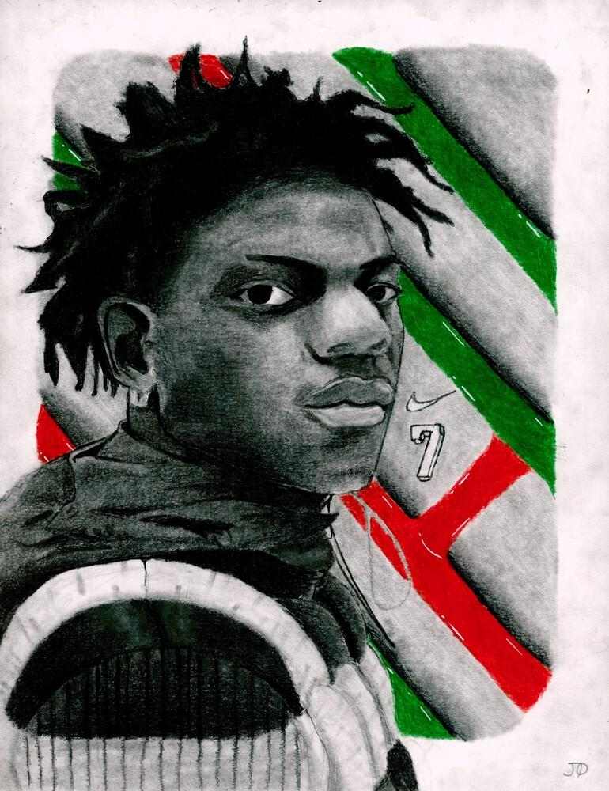
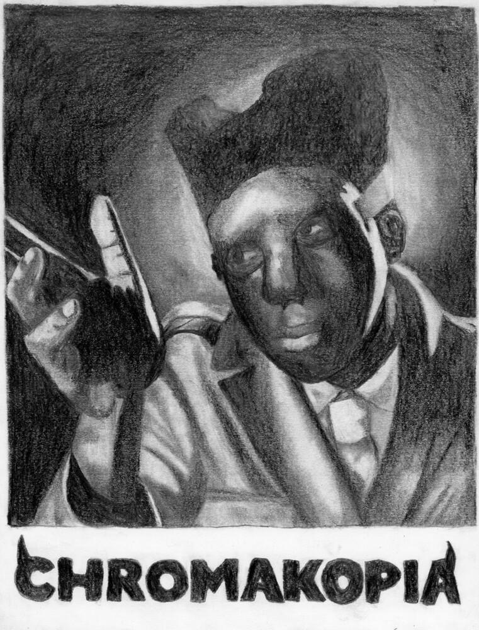
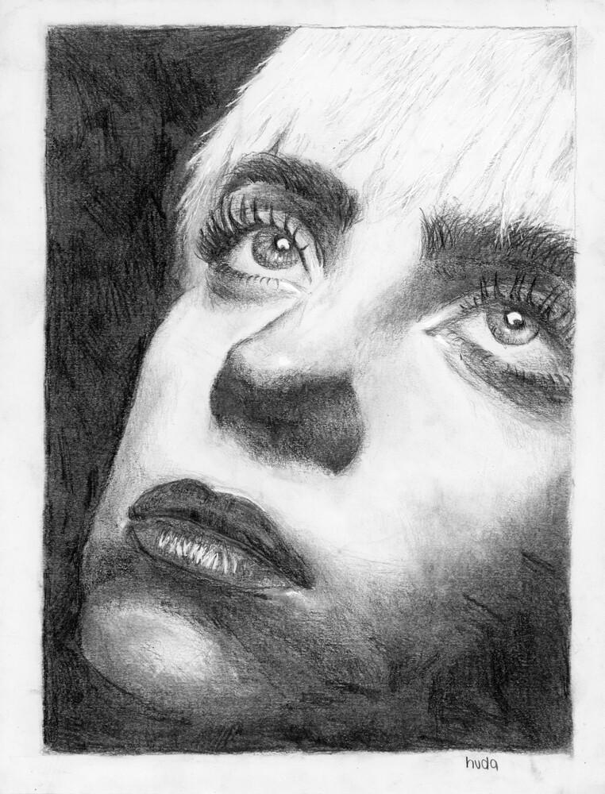
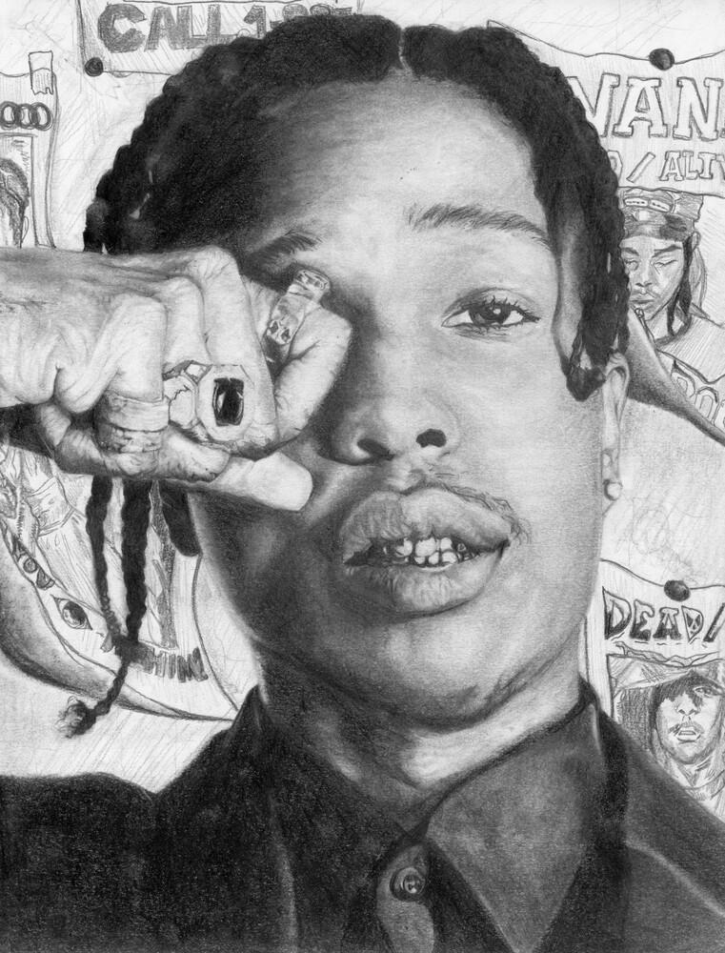
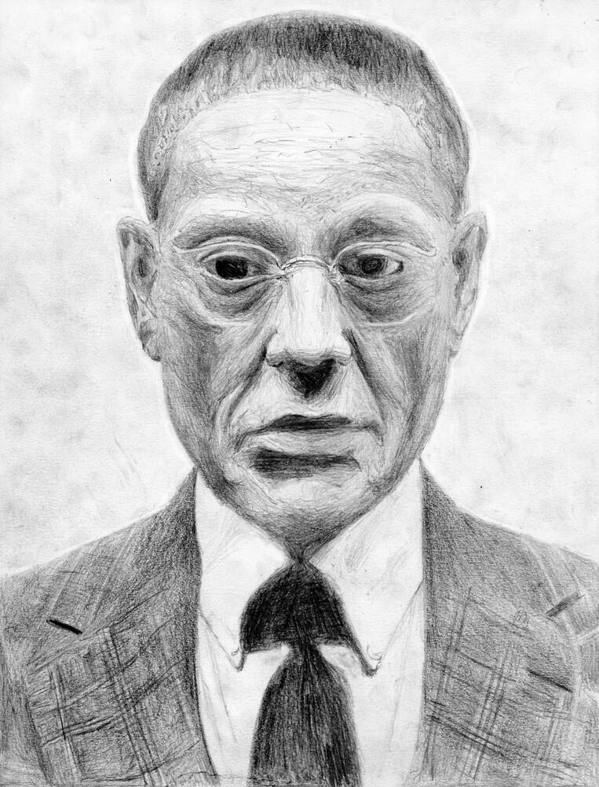
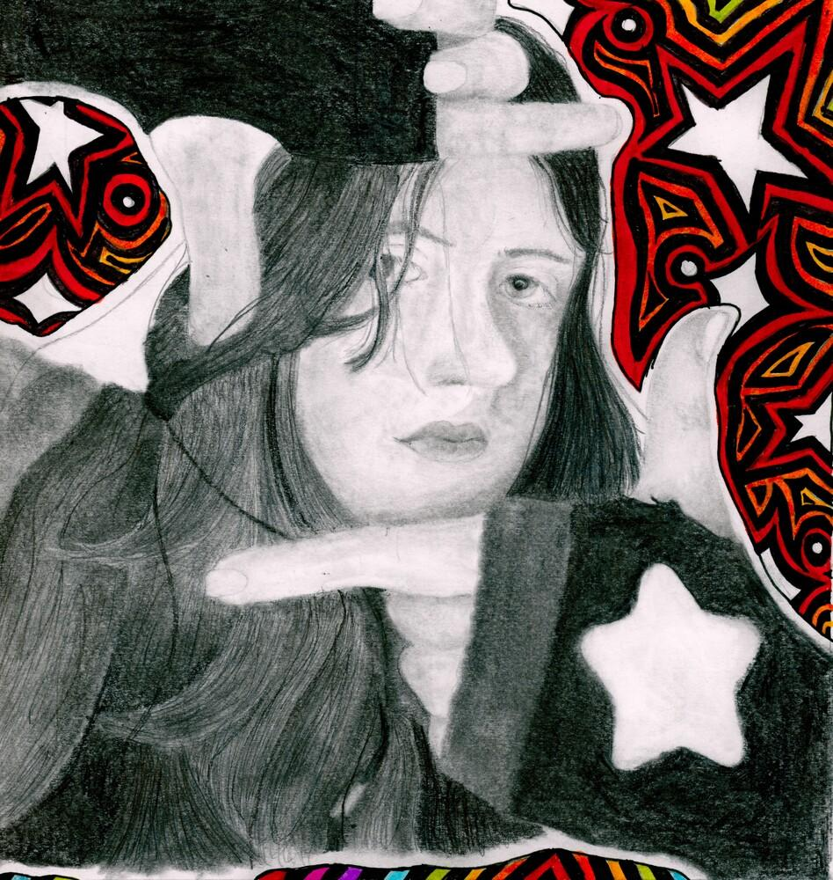
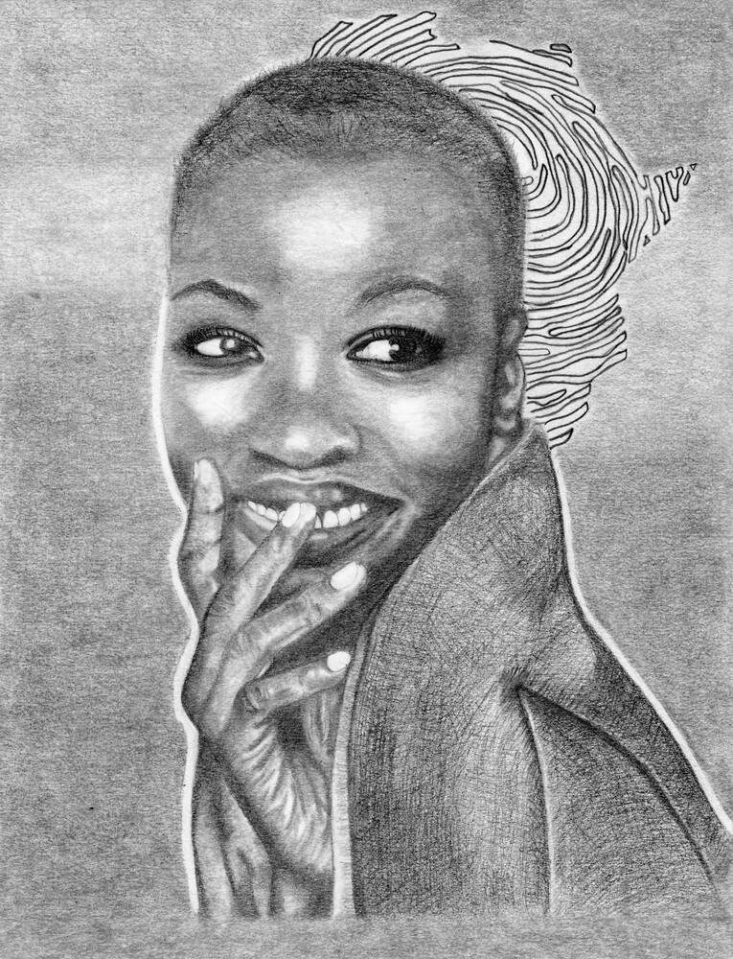
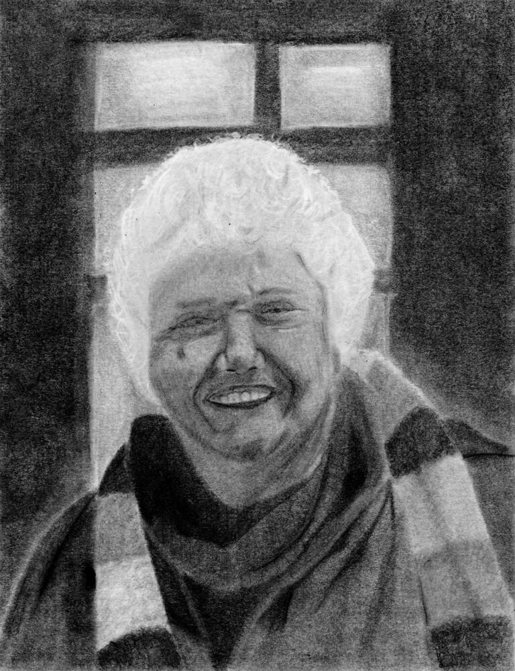
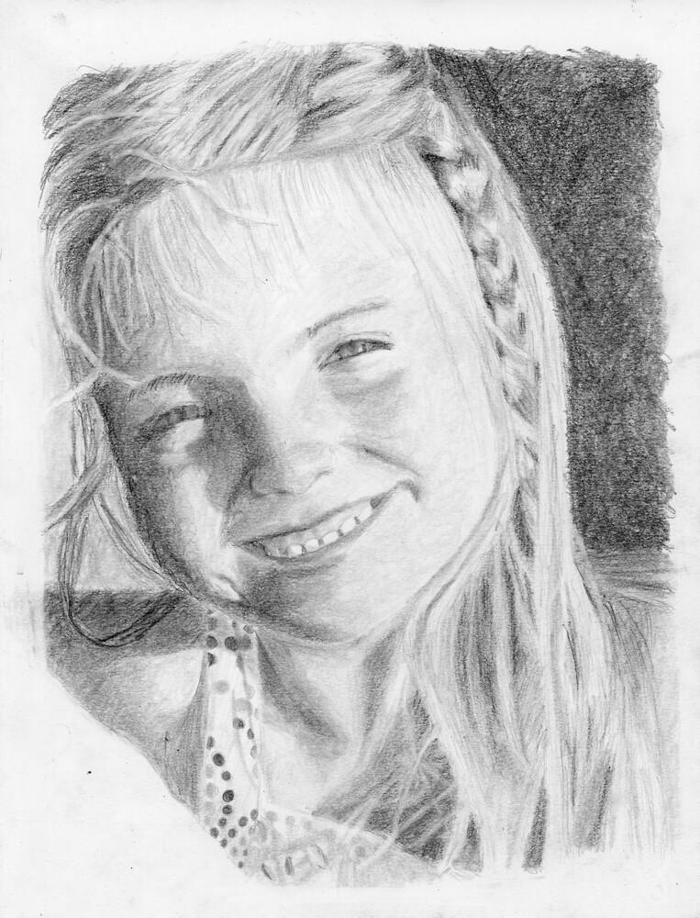
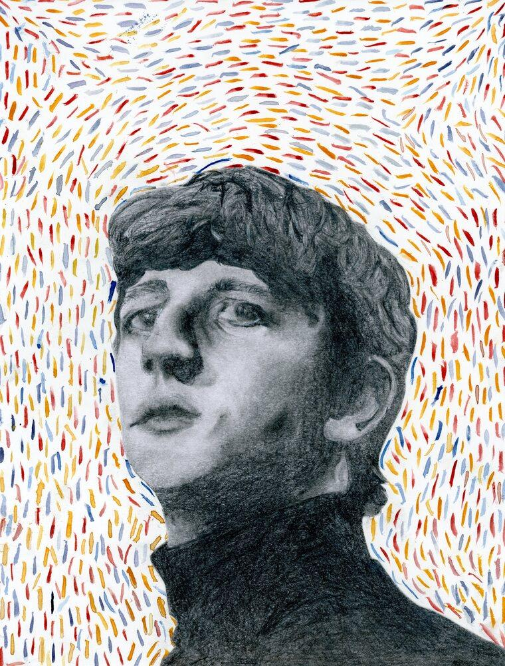
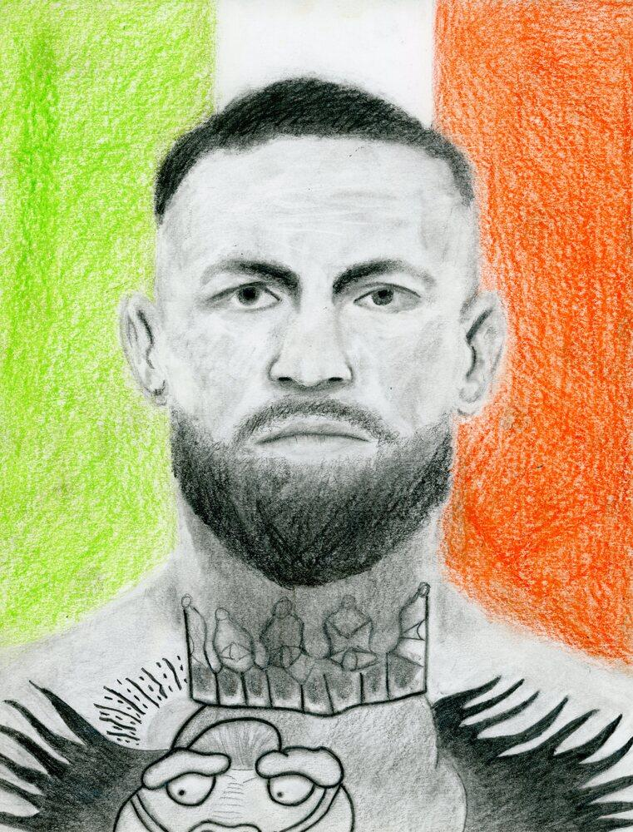
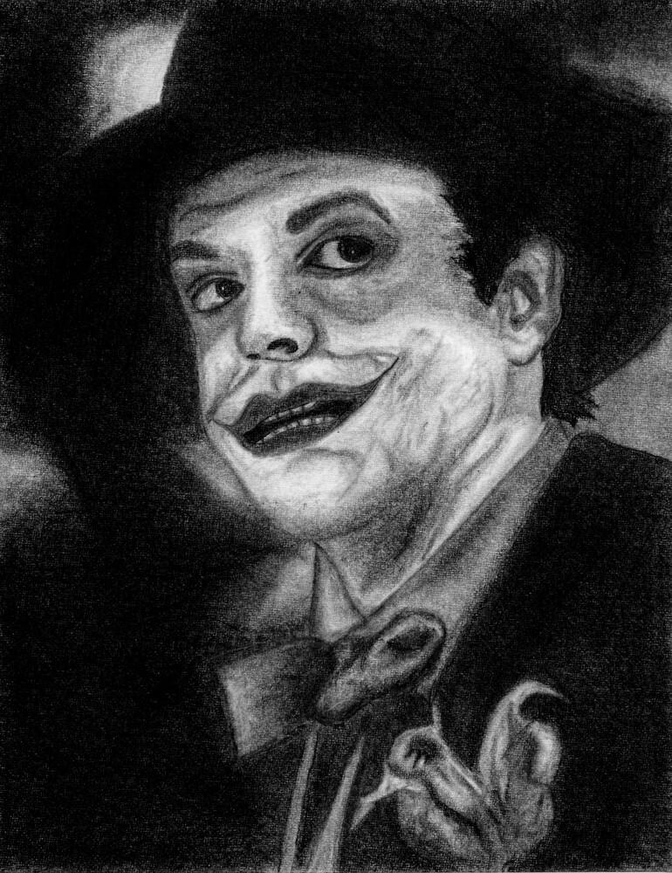
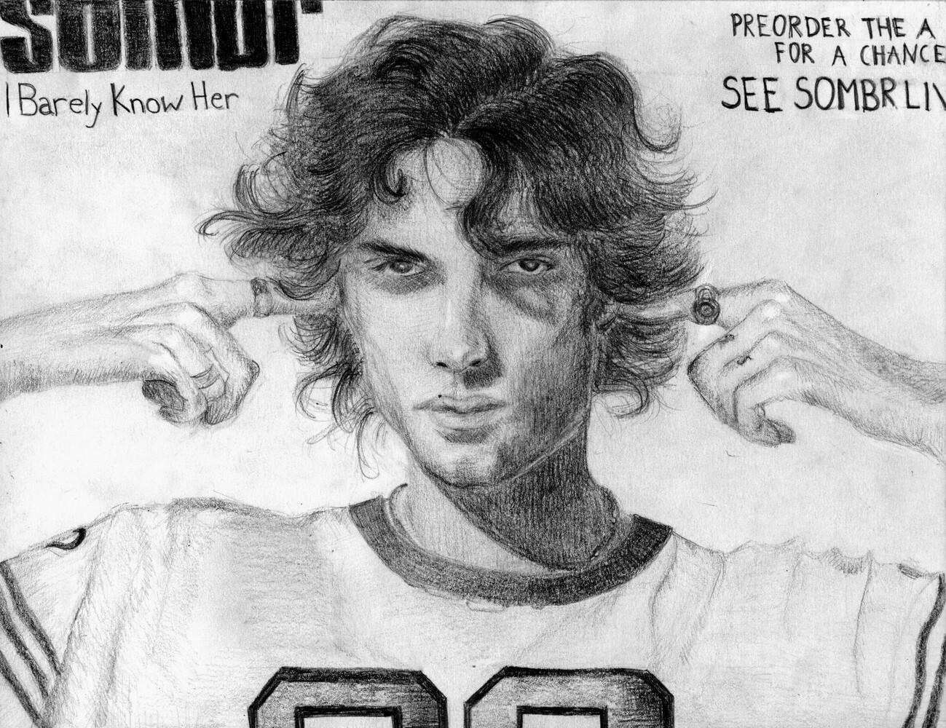
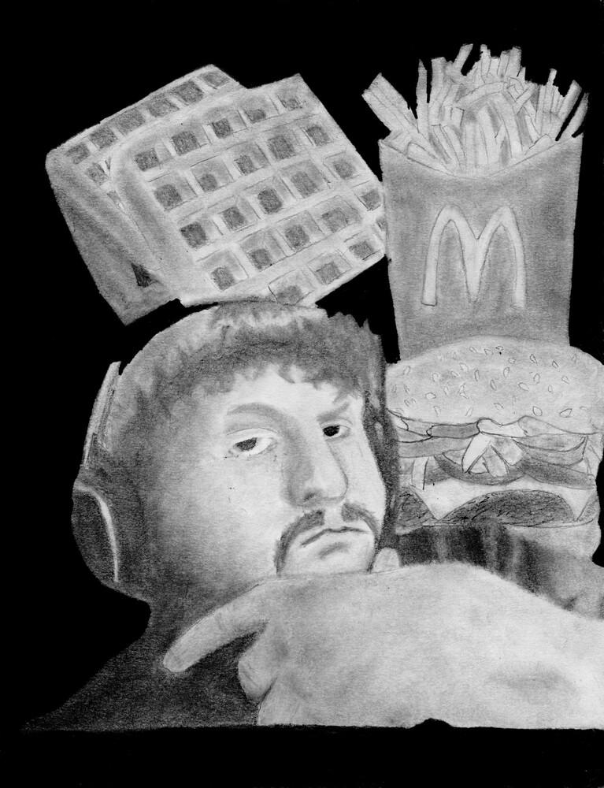
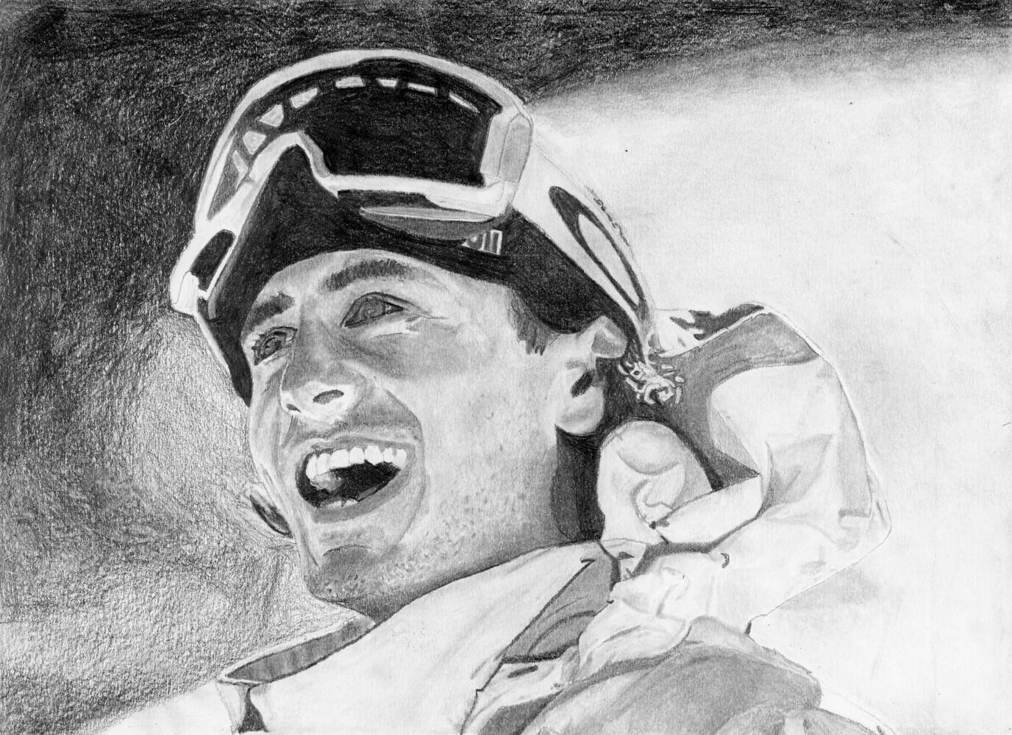
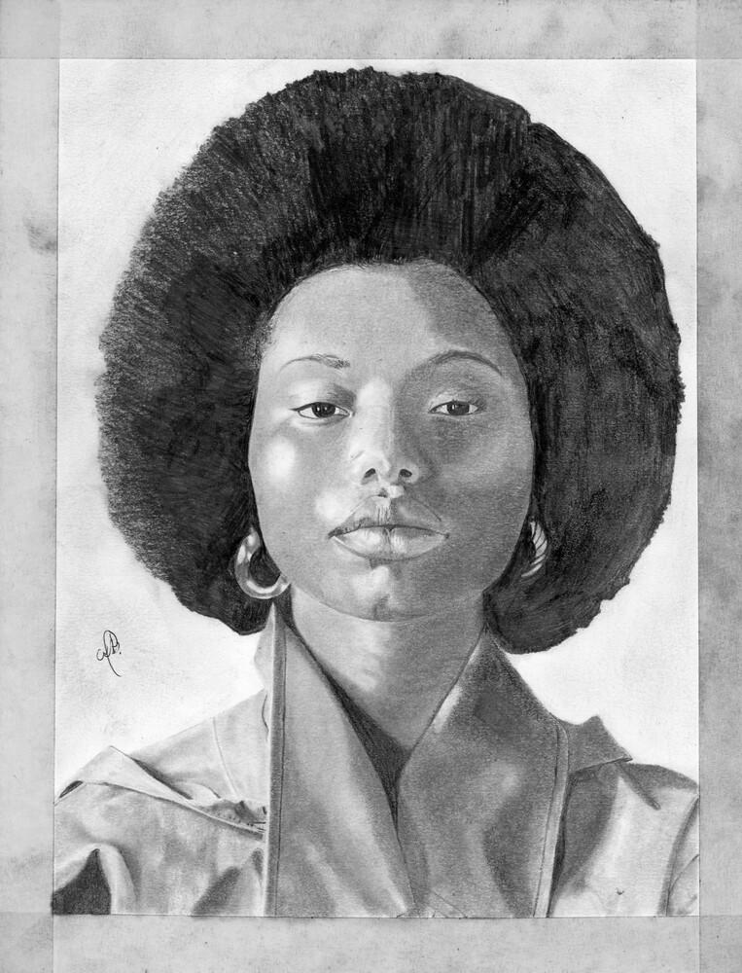
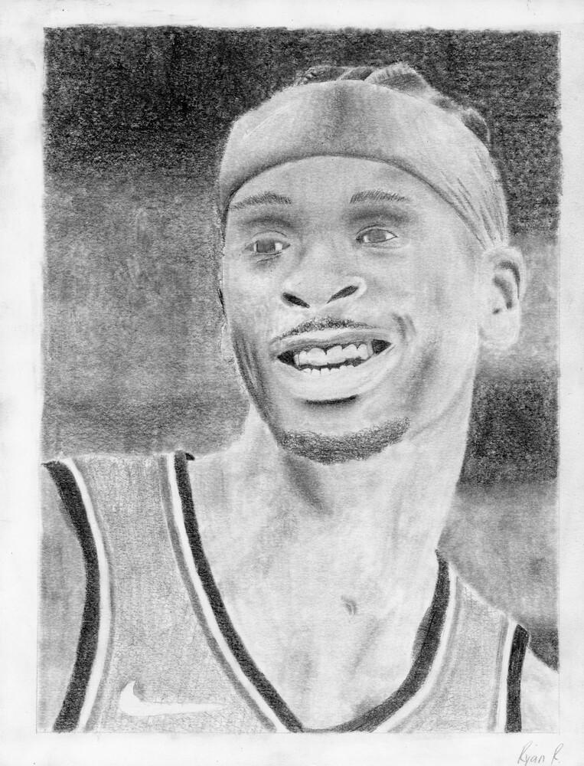
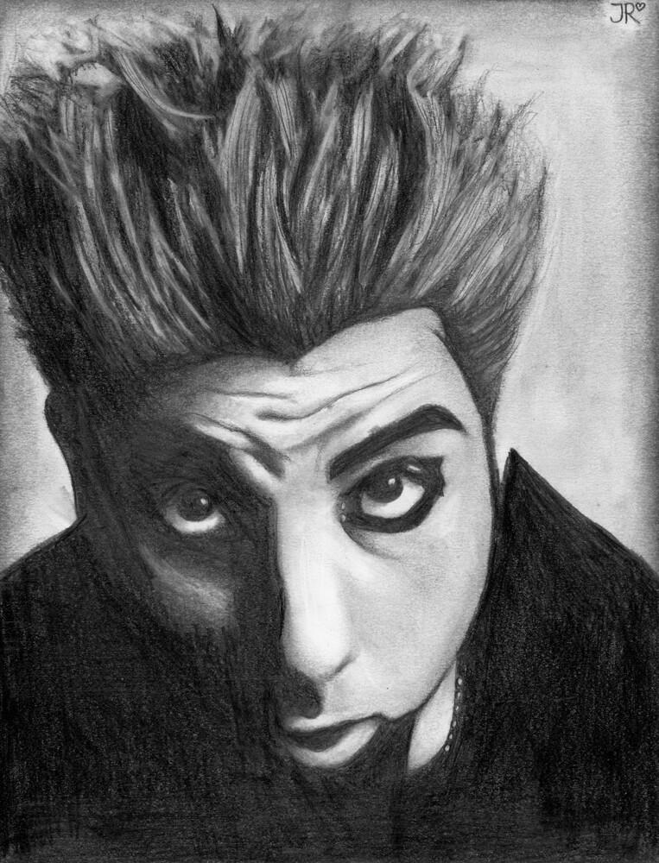
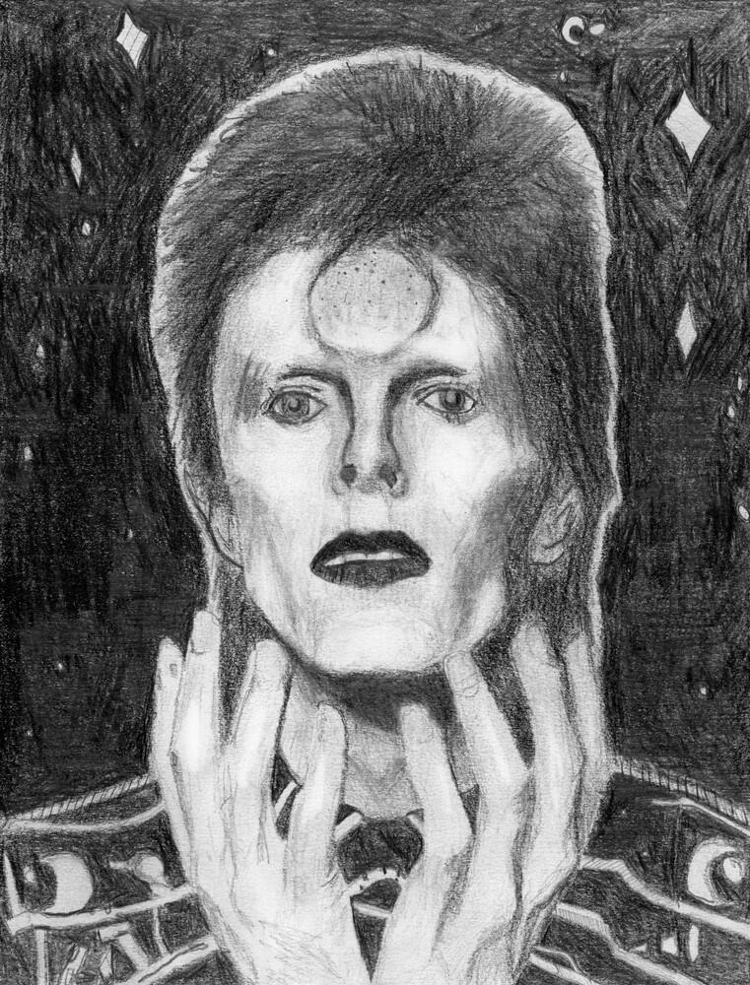
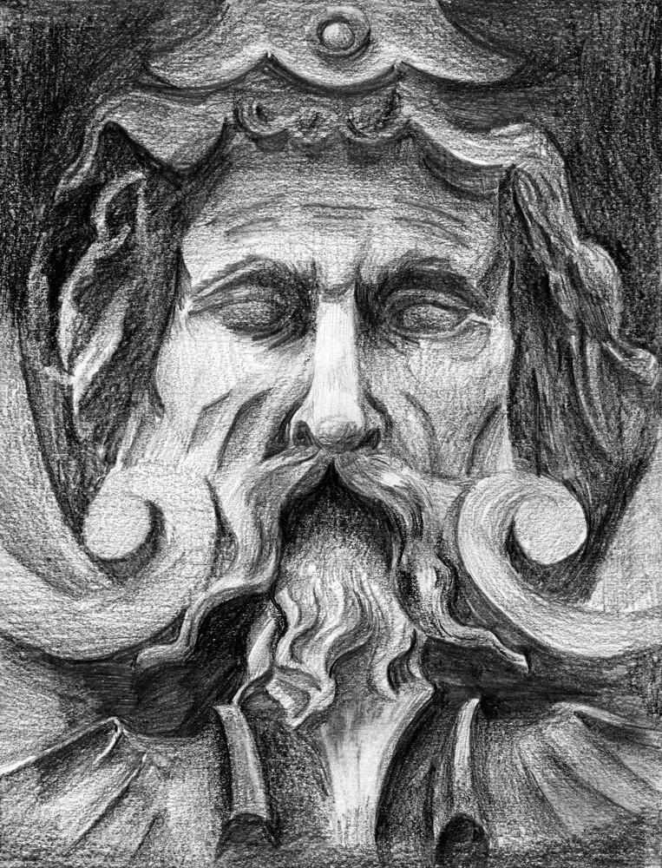
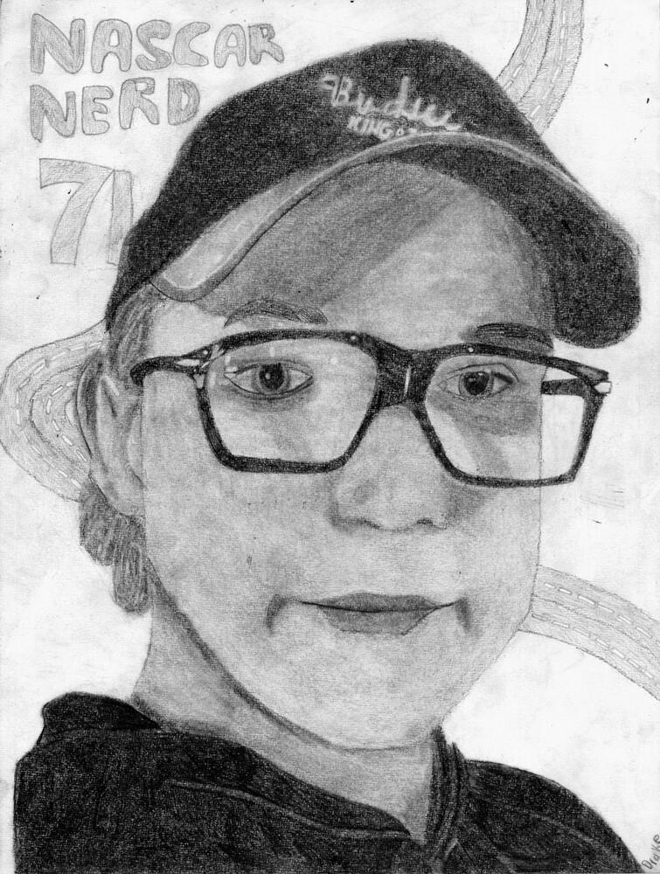
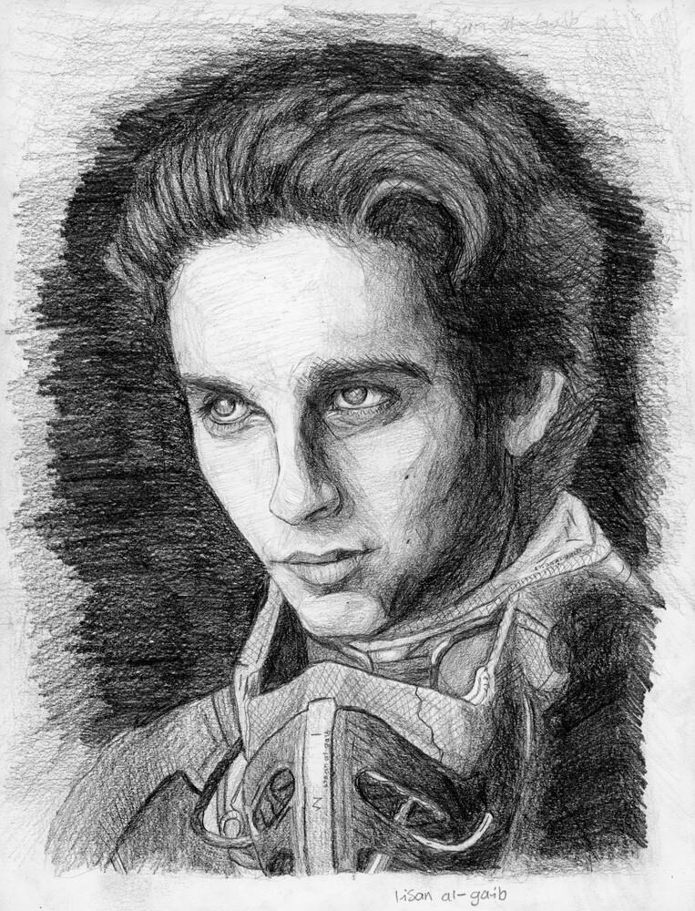
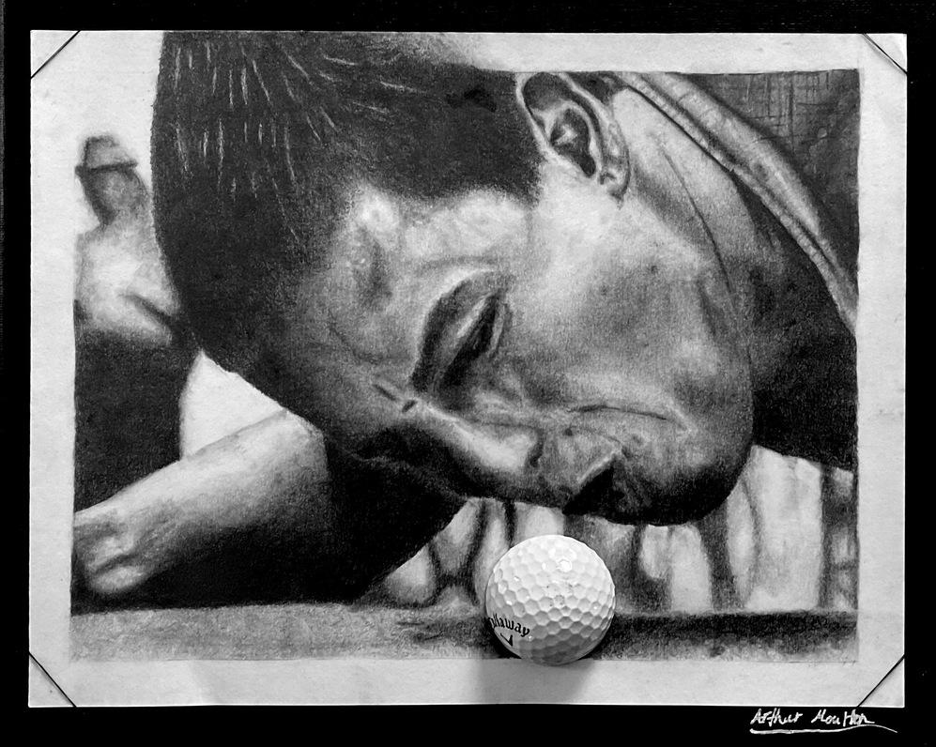
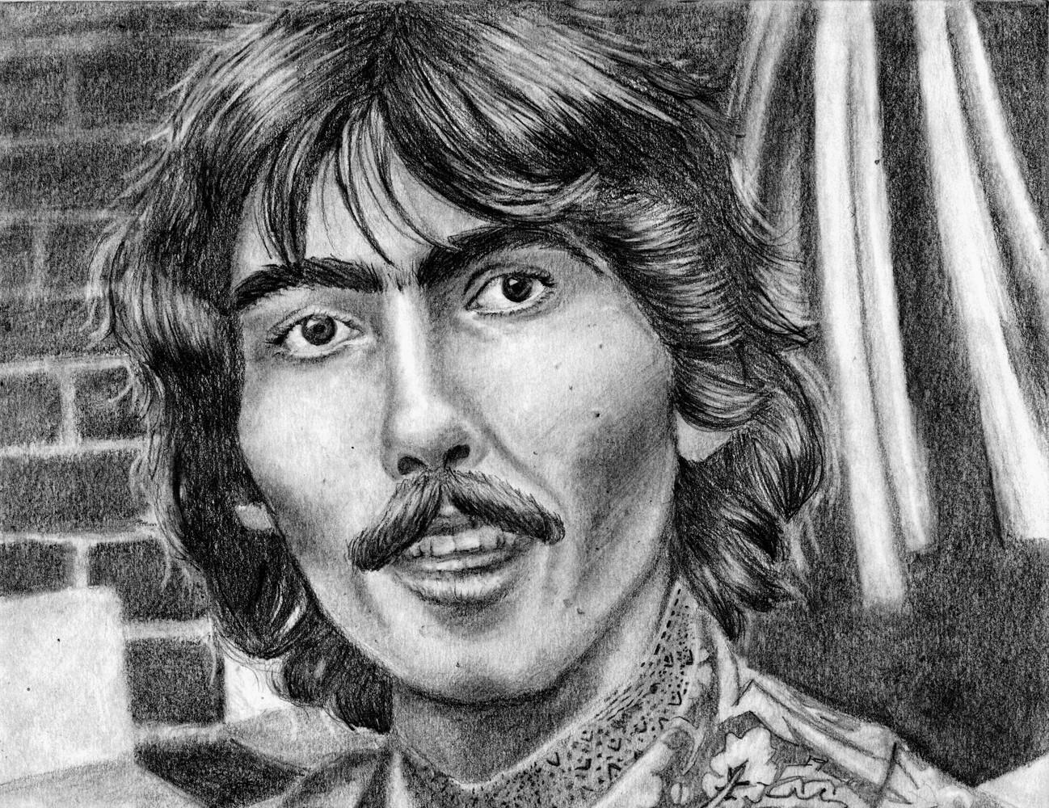
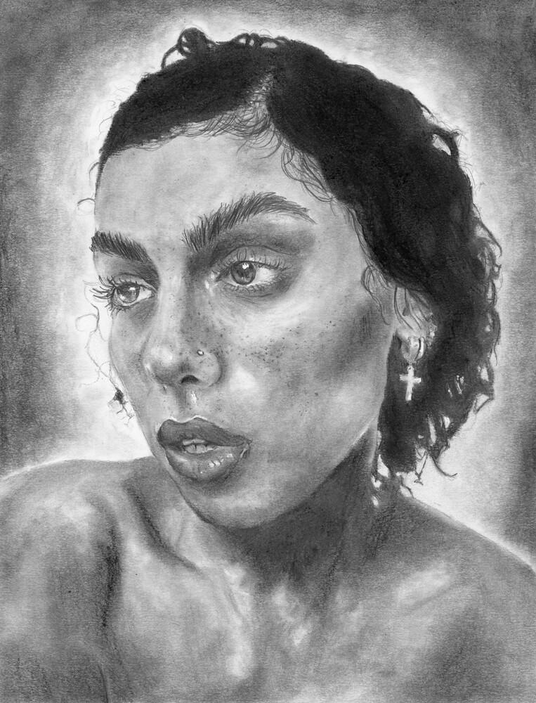
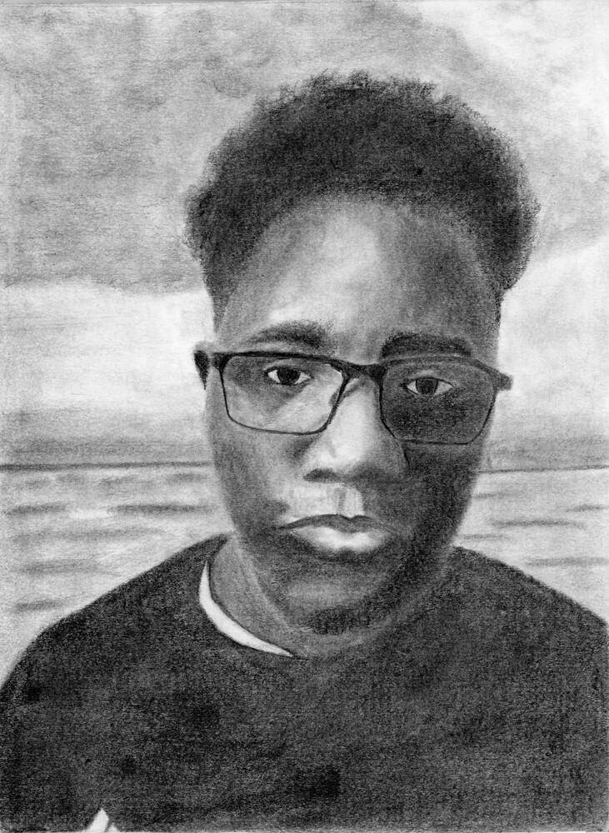
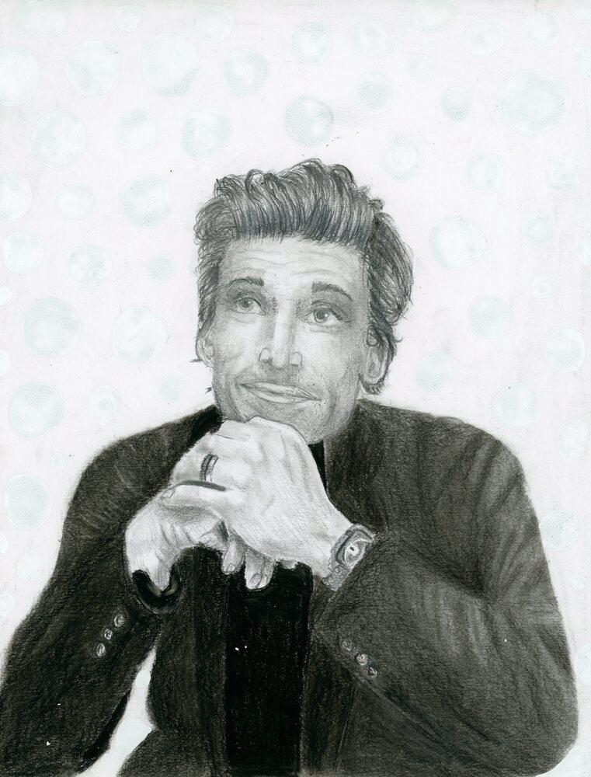
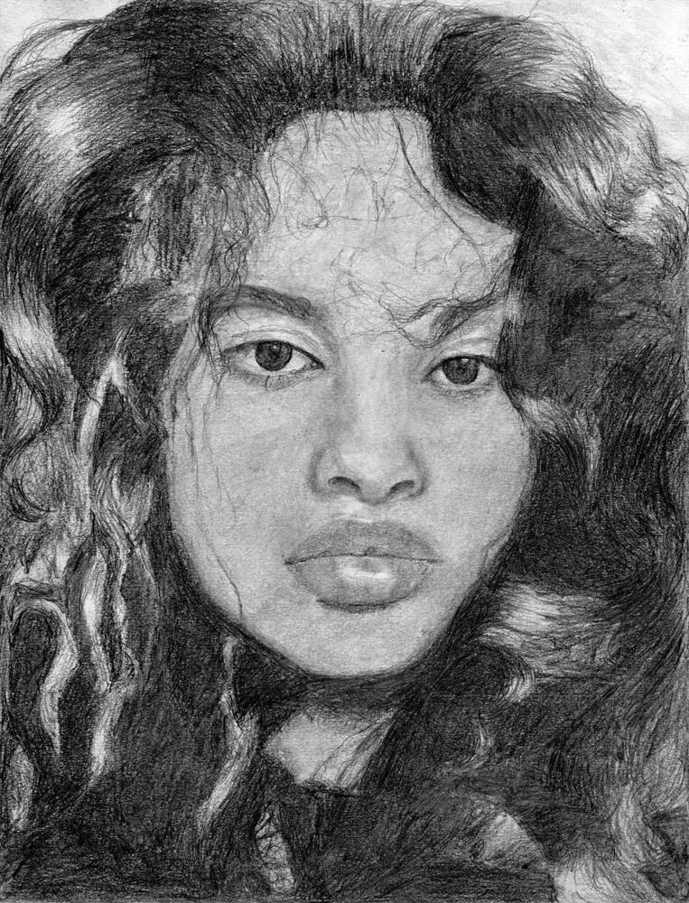
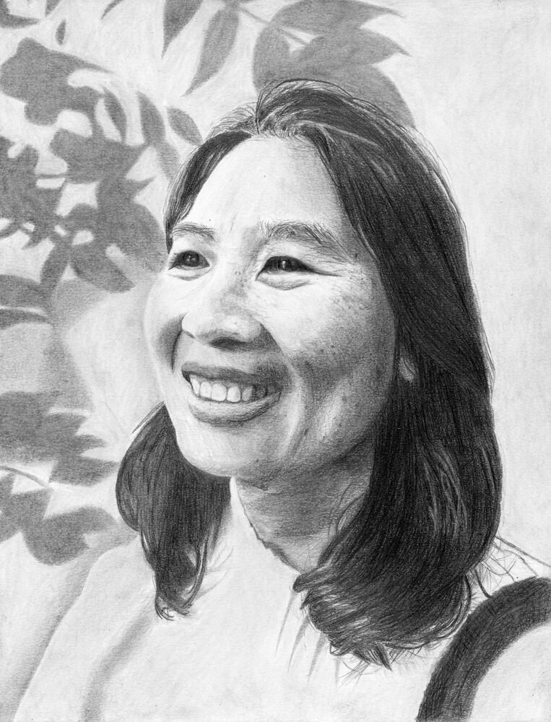
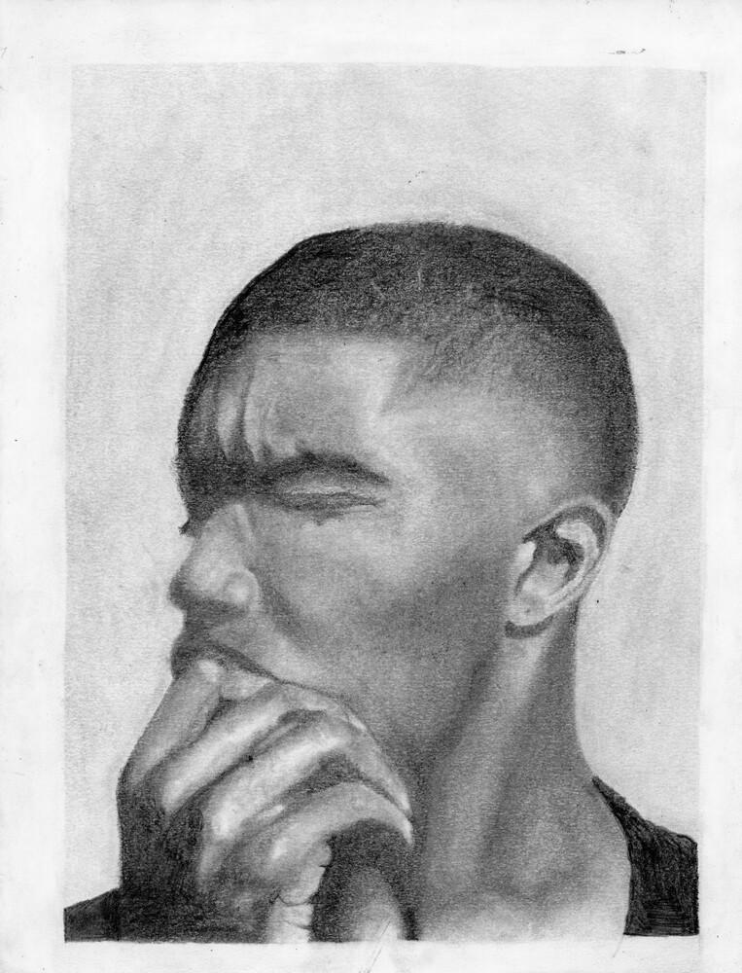
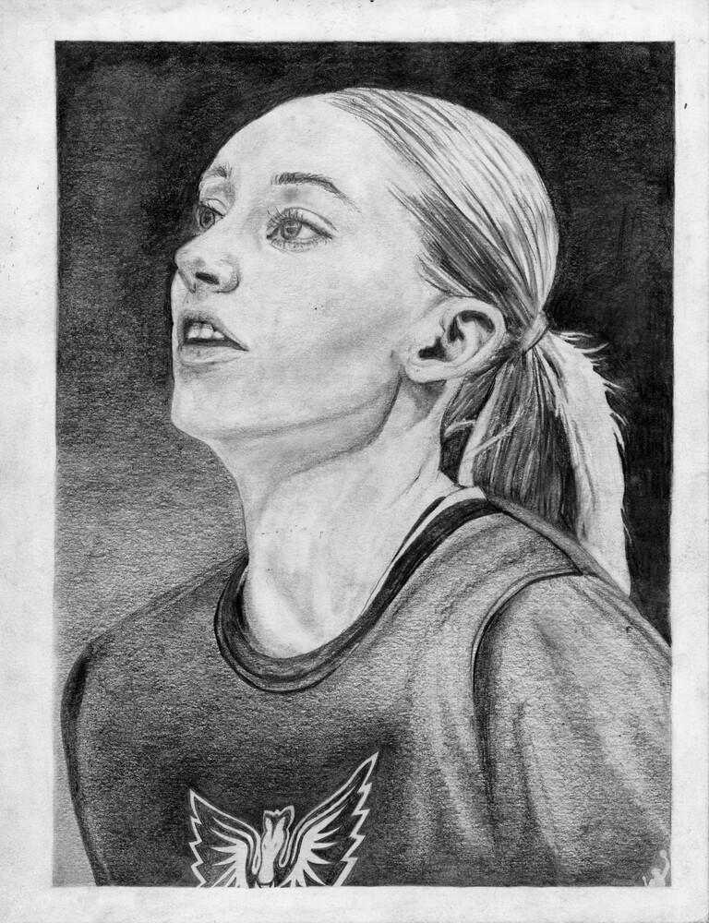
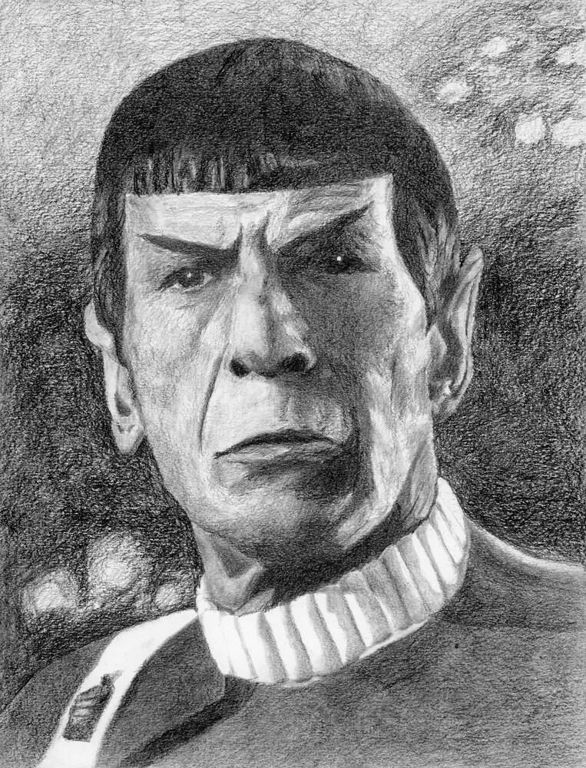
Cohen Demers, Fall 2025
Huda Elkord, Fall 2025
Justine Parreno, Fall 2025
Lochie Forde, Fall 2025
Kateryna Bilash, Fall 2025
Oliver Rutherford, Fall 2025
Matthew Mackey, Fall 2025
Covenant Bassey, Fall 2025
Ryan Rice, Fall 2025
Chloe Willett, Fall 2025
Jurni Robinson, Fall 2025
Arthur Moulton, Fall 2025
Portrait
________ Hand drawing (contour)
________ Stravinsky (contour)
________ The Woodcutter (shading)
________ Pears (blending)
________ Parts of the face
________ Hair textures
_____/10 Progress & goals
Advait Abhilash, Fall 2025
Matina Kyriakakos, Fall 2025
Jaiyla Slaunwhite, Fall 2025
Criteria for your finished Portrait:
Technique: Proportion & detail
Accurate shapes, sizes, and contour
Technique: Shading
Deep blacks, smooth, and well blended
Composition
Complete, full, finished, and balanced
Upshaw, Fall 2024

Slide 2
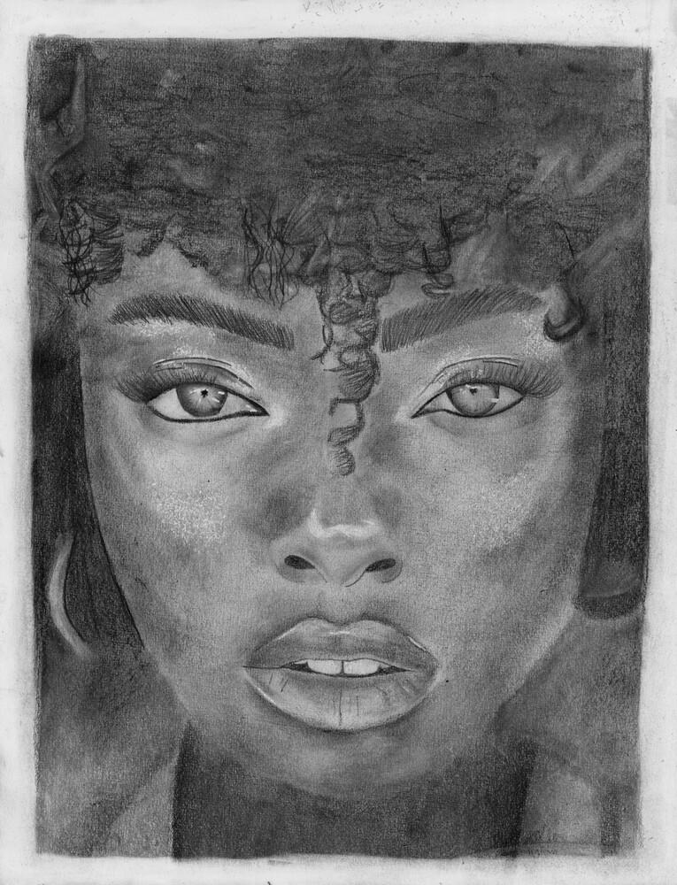
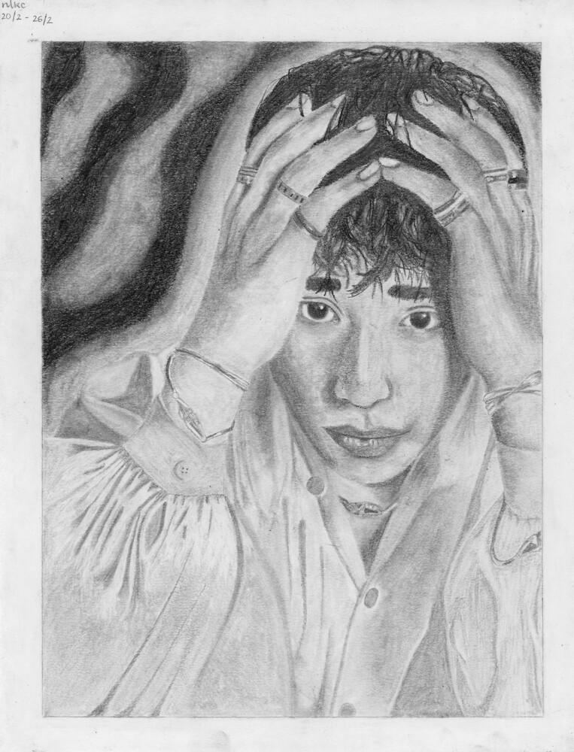
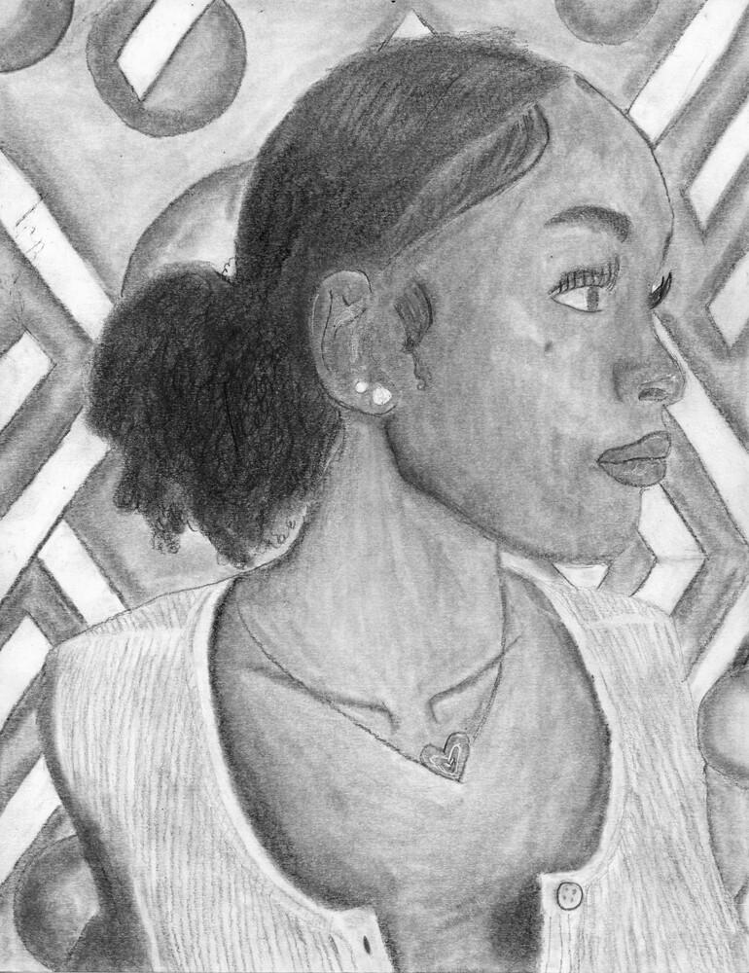
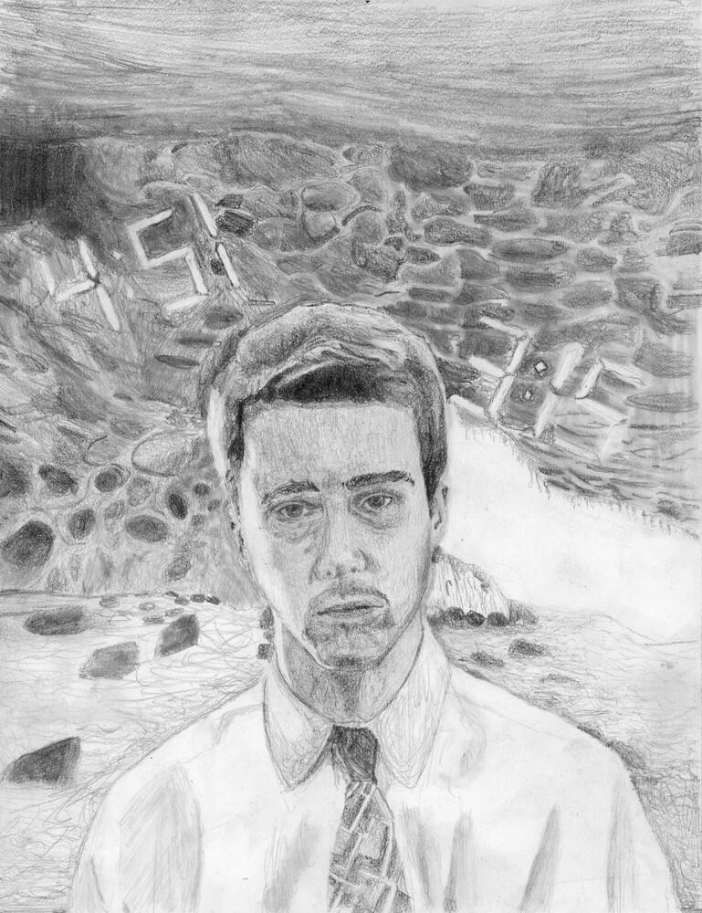
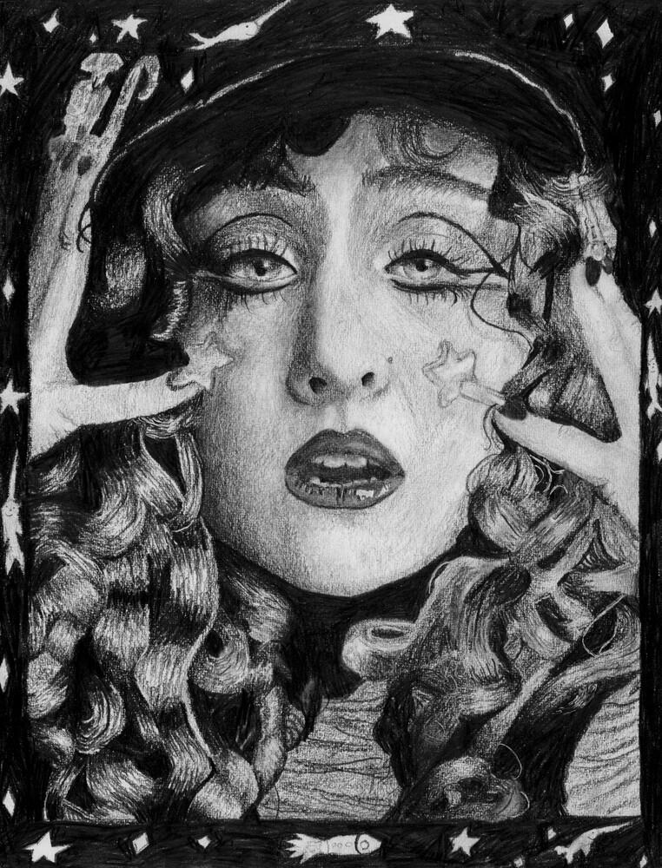
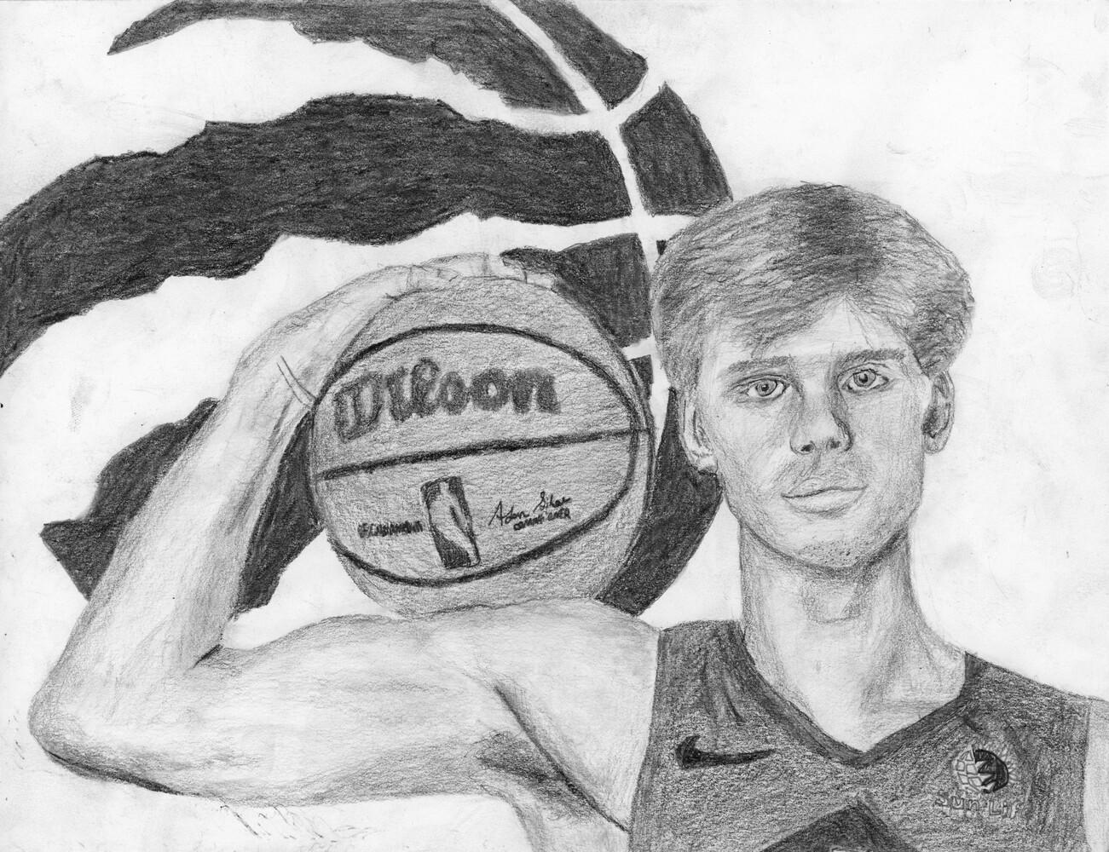
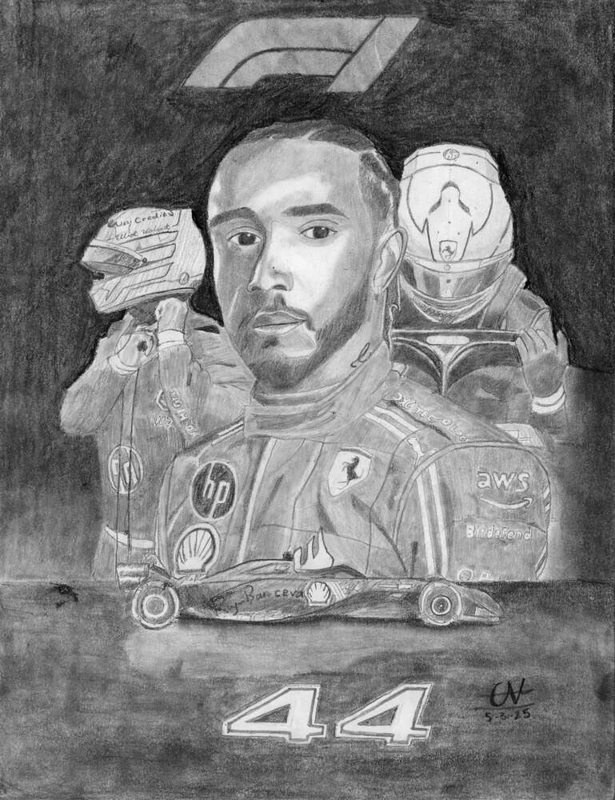
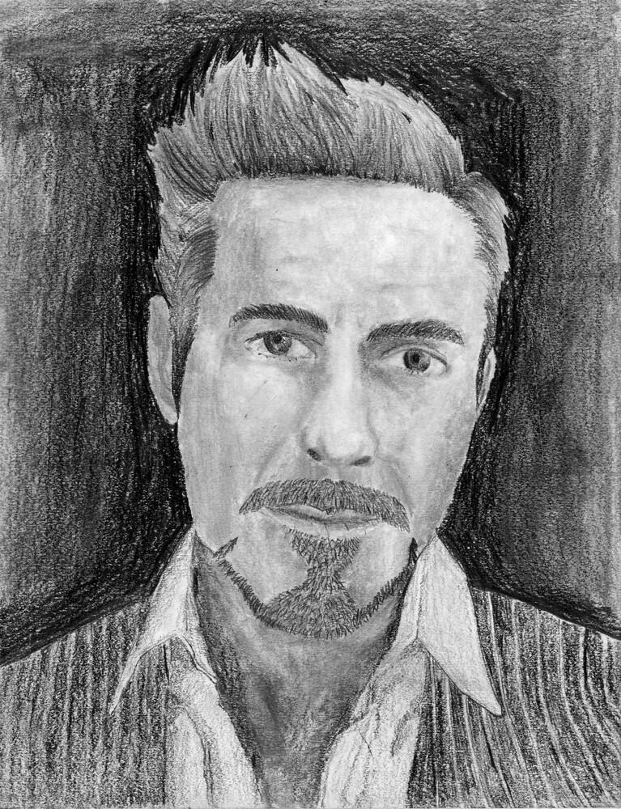
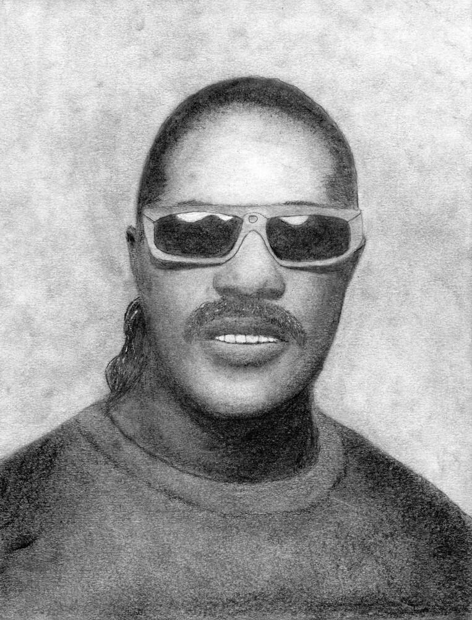
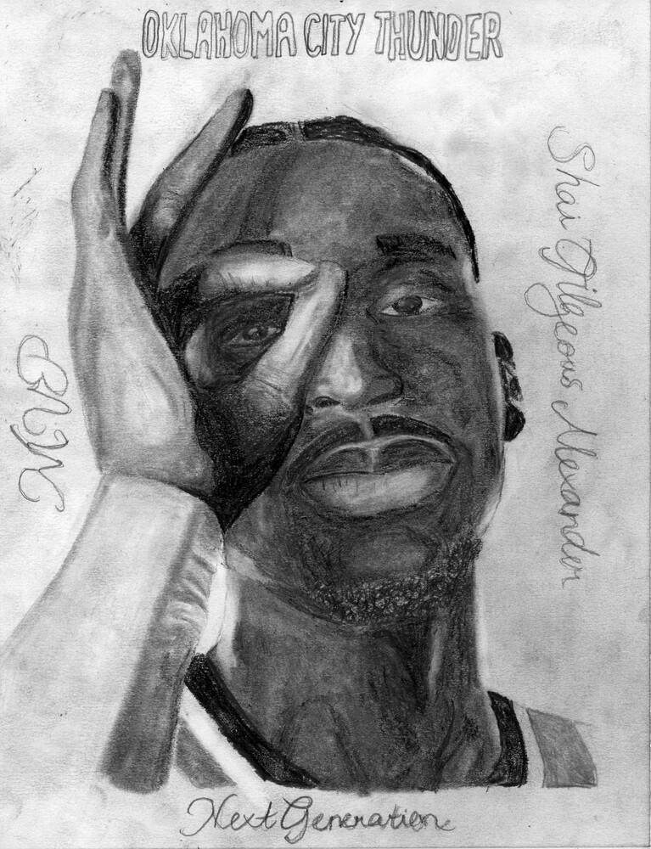
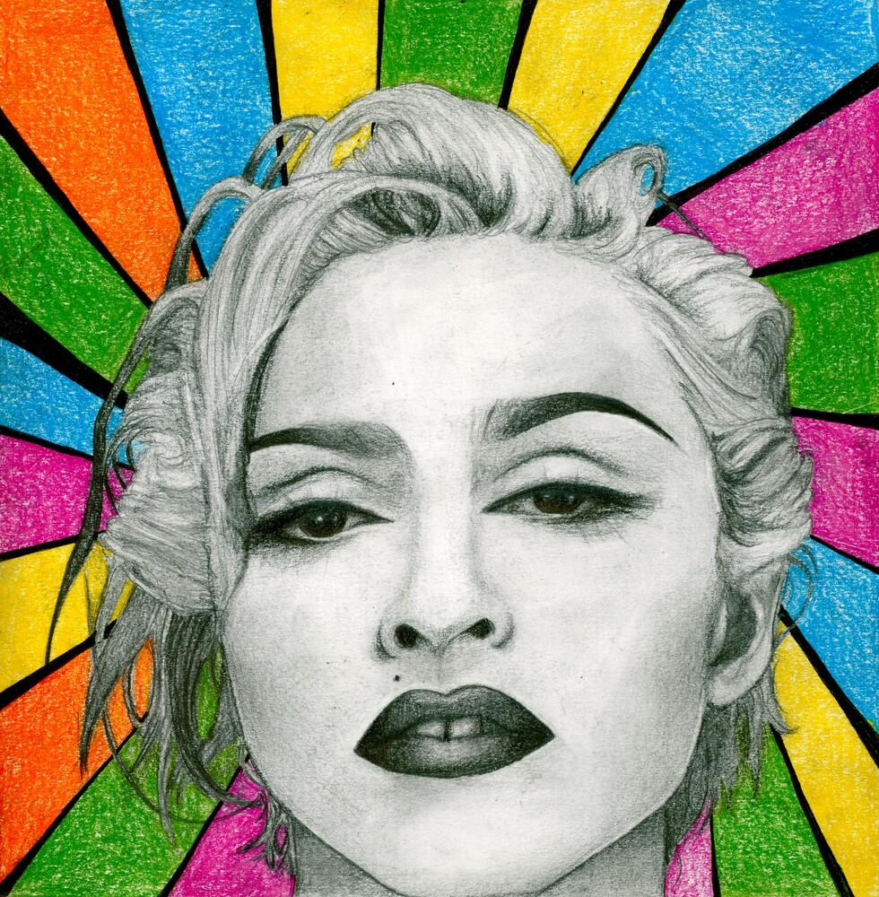
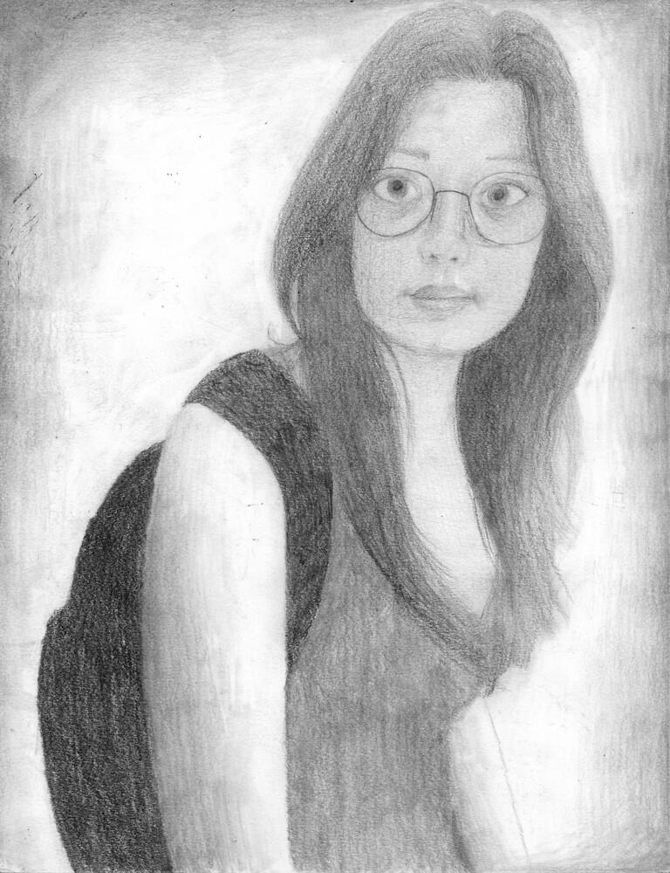
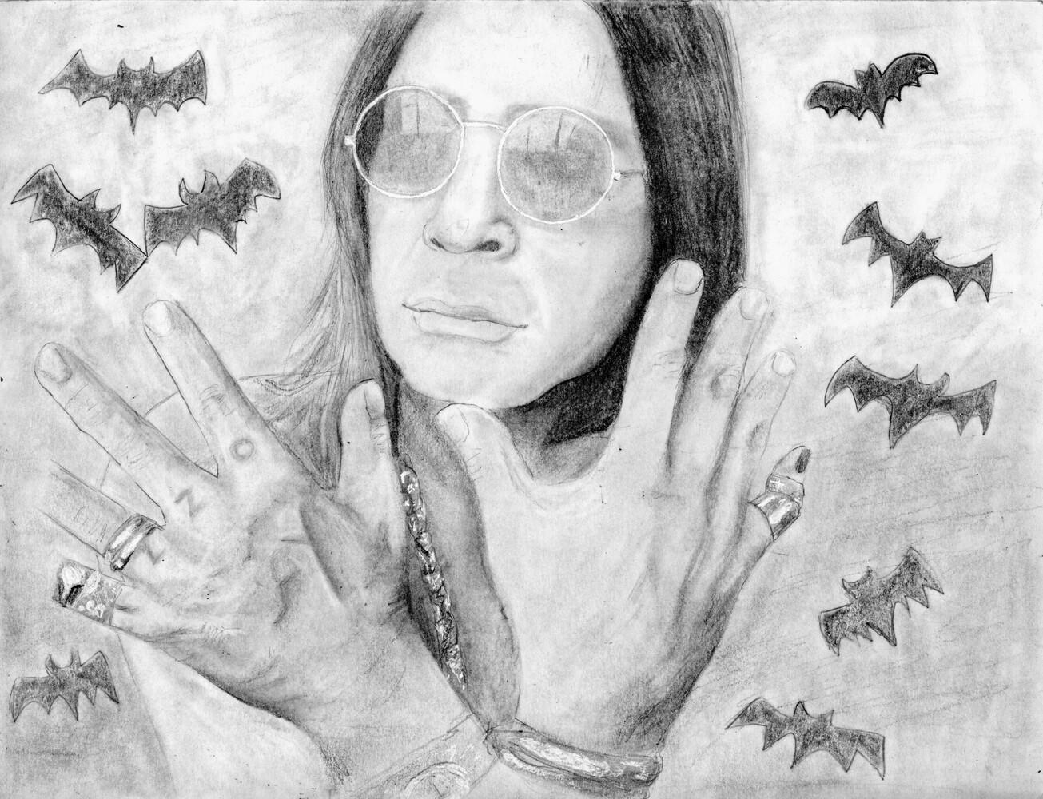
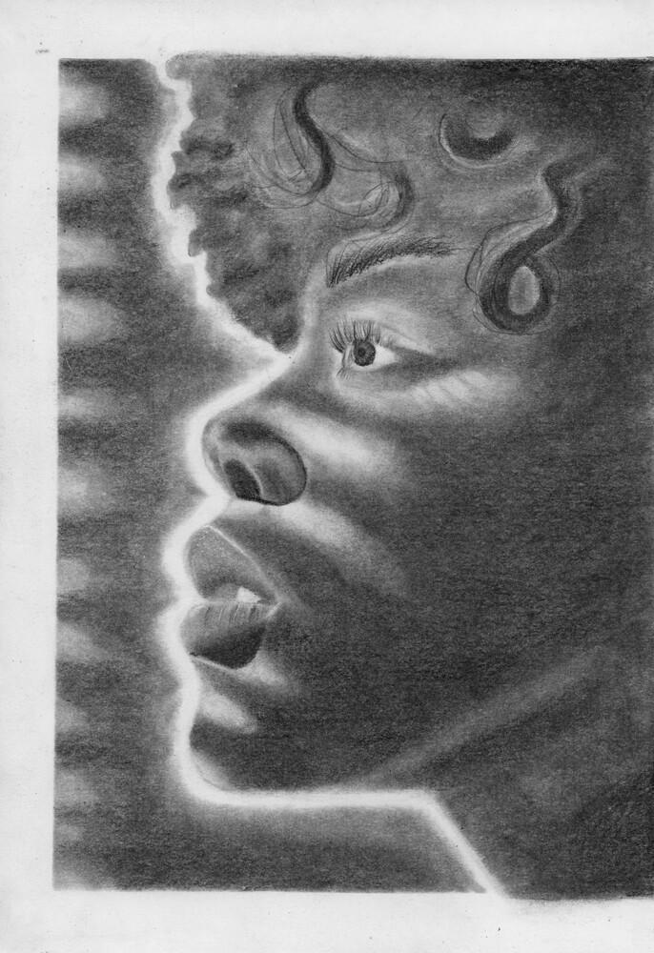
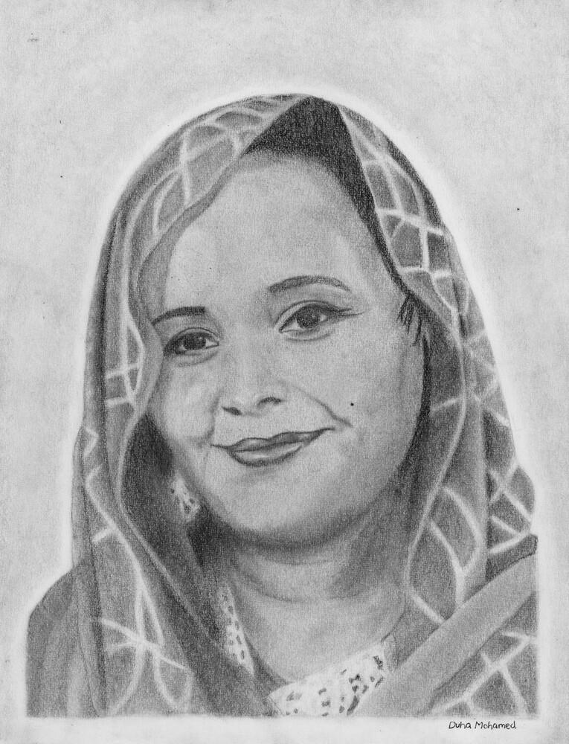
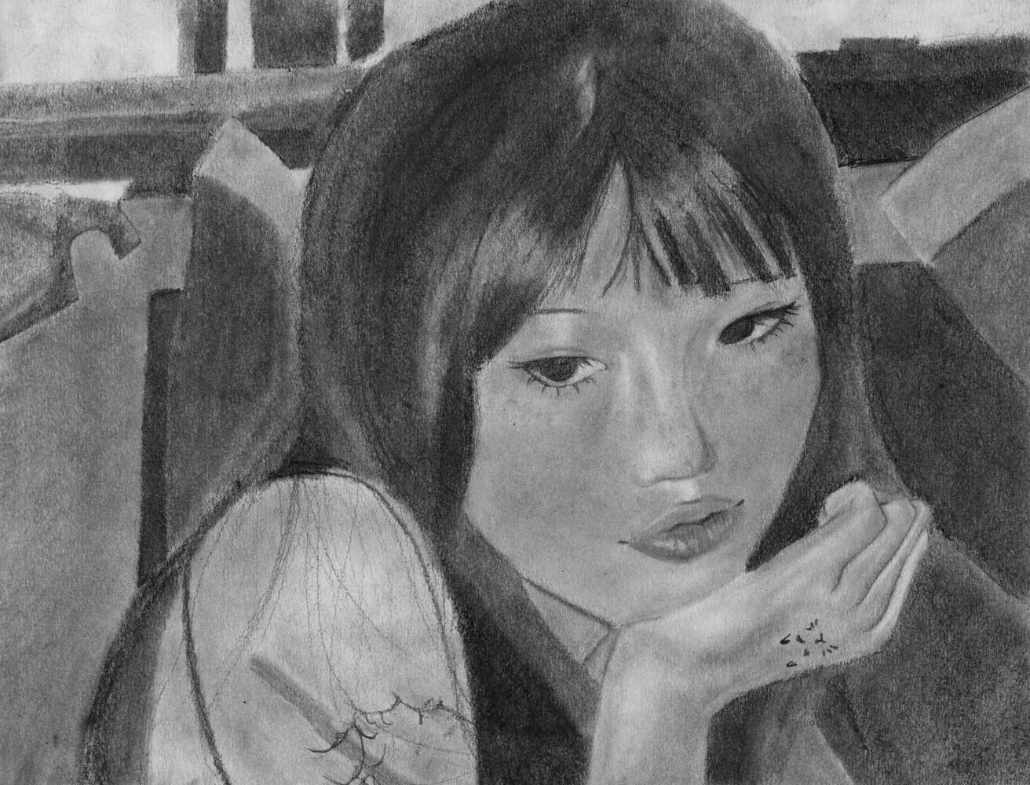
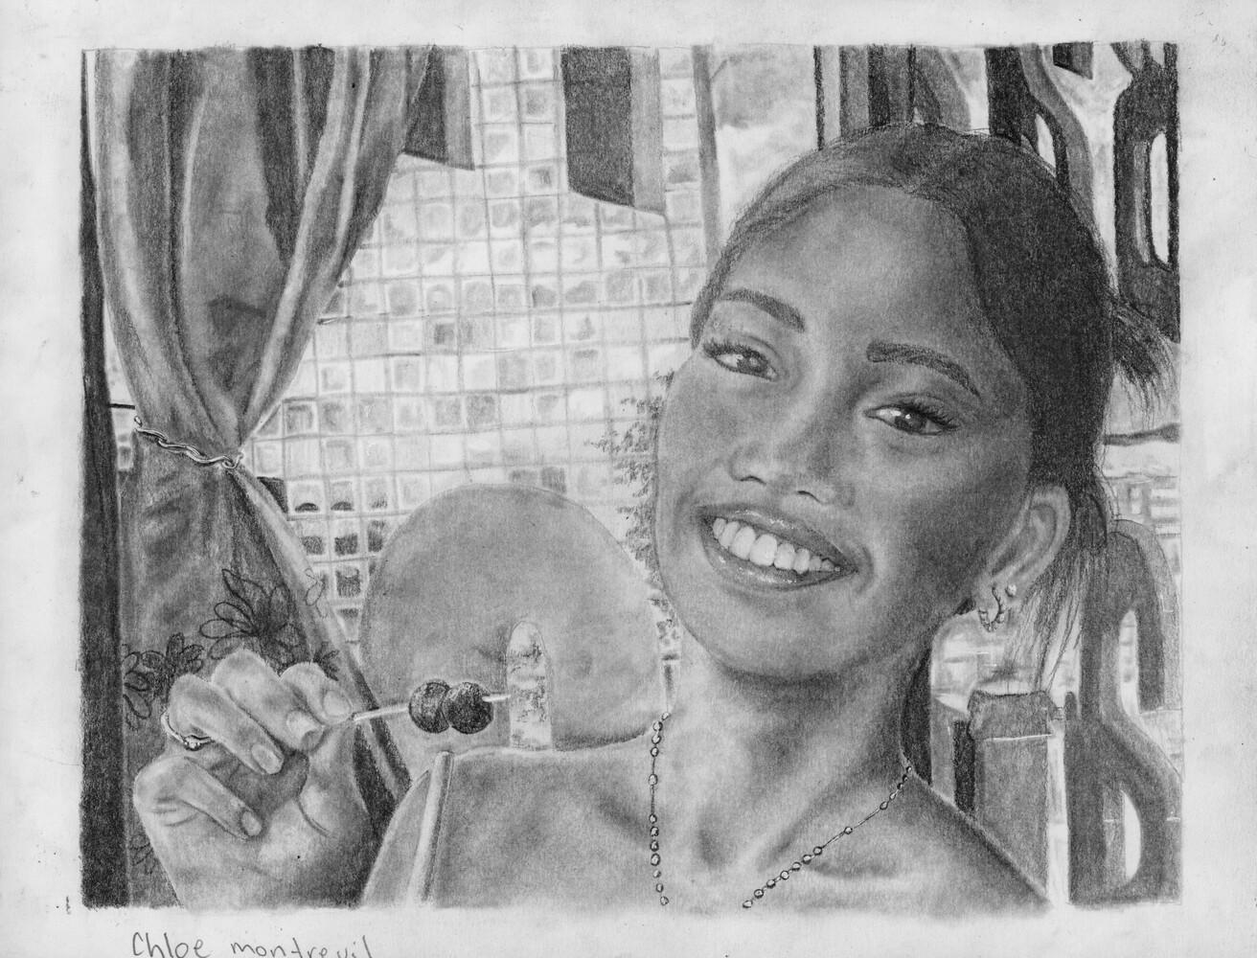
Andrea Castillo, Spring 2025
Cecilia Nguyen, Spring 2025
Yohana Tedla, Spring 2025
Ted Stevens, Spring 2025
Nathan Parks, Spring 2025
Leo Hilewitz, Spring 2025
Elliot Valiant, Spring 2025
Gavin Black, Spring 2025
Seth Cogswell, Fall 2025
Sophie MacDonald, Spring 2025
Rowan Pottie, Spring 2025
Kaylie Gray, Spring 2025
Kylee Marryatt, Fall 2025
Hana Jeong, Spring 2025
Dhuha Mohamed, Spring 2025
Chris-Ann Richards, Spring 2025
Chloe Montreuil, Spring 2025
Upshaw, Fall 2024

Slide 3
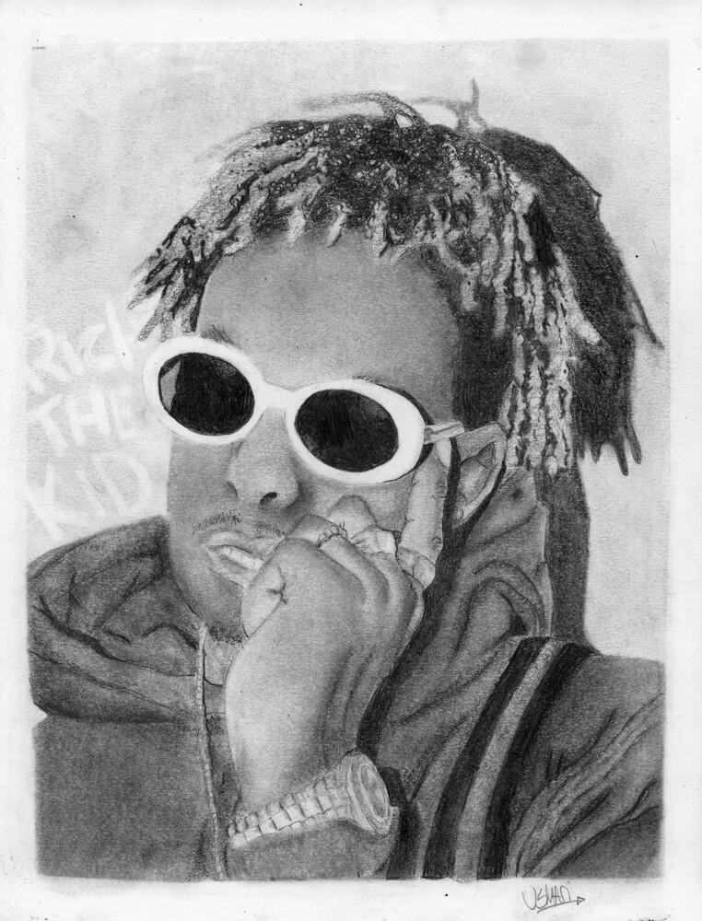
















Usman Arifov, Fall 2024
Sydney DeMings, Fall 2024
Brady Nielsen, Fall 2024
Leeluu Derouchie, Fall 2024
Yvette Lai, Fall 2024
Liam Carney, Fall 2024
Greta McLaren, Fall 2024
Emma Savoie, Fall 2024
Kauthar Green, Fall 2024
Eli Webber, Fall 2024
Lydia Marryatt, Fall 2024
Ronan Surette, Fall 2024
Sofia Tucker, Fall 2024
Neve McGrath, Fall 2024
Akiyrah Stevenson, Fall 2024
Ruby Hilewitz, Spring 2025
Isaiah Taranza, Spring 2025

Slide 4



















Morgan Marks, Spring 2024
Gabriel Correia, Spring 2024
Raquel Khoury, Spring 2024
Ella Brimacombe, Spring 2024
Quinn Ryall, Fall 2024
Lara Calder, Spring 2024
Taliyah Walter, Fall 2024
Scarlett Reynolds, Spring 2024
Nora Sutherland, Spring 2024
Zachary Dufour, Fall 2024
Anita Izadi, Spring 2024
Lena Epstein, Spring 2024
Sarthak Gade, Spring 2024
William McLeod, Fall 2024
Shreena Sen, Fall 2024
Sasha Kolokolnikov, Spring 2024
Darnell Upshaw, Spring 2024
Kate Morgan-MacFadyen, 2024
Catherine Fraser, Spring 2024

Slide 5


















Xintang Wang, Fall 2023
Chloe Taylor, Fall 2023
Arik Arik, Fall 2023
Mariah Wentzell, Fall 2023
Matt Inkpen, Fall 2023
Carter Jecks, Fall 2023
Ahsan Amir, Fall 2023
Olivia Woodill, Fall 2023
Mya Honey, Fall 2023
Gaelle Bousquet, Fall 2023
Lily Campbell, Fall 2023
Mya Rimmer, Fall 2023
Emmy Bickerton, Fall 2023
Sophia Rogers, Fall 2023
Opemipo Ajetomobi, Spring 2024
Joshua Richardson, Spring 2024

Slide 6









Mica Paul, Spring 2023
Max Seale, Spring 2023
Sophia Falle, Spring 2023
Reid Gillis, Spring 2023
Johnylah James, Spring 2023
Elle Langley, Spring 2023
Lexy Berry, Spring 2023
Alexa Maillet, Spring 2023
Andel Brown, Fall 2023

Slide 7









Lena Ubani, Fall 2022
Erin Kells, Fall 2022
Tyler Lafitte, Fall 2022
Siyun Lee, Fall 2022
Parker Smith, Fall 2022
Cecily Harnum, Fall 2022
Leelah Makhoul, Fall 2022
Drew Gooding, Fall 2022
Kokheb Tesfatsion, Spring 2023

Slide 8









Jace Barrett, Spring 2022
Mychal Sullivan, Spring 2022
Brennan Murphy, Spring 2022
Olivia Sullivan Newhook, Spring 2022
Debbie Belachew, Spring 2022
Zhihao Di, Spring 2022
Ayla/Zane Brown, Fall 2022
Amebe Ngei, Spring 2022
Airon Miko Ortega, Spring 2022

Slide 9









Seongjin Kim, Fall 2021
Grote Rodriguez , Fall 2021
Sophia Hewitt, Fall 2021
Jo Scanlan-Casey, Spring 2022
Ajulu Omod, Fall 2021
Bishir Green, Fall 2021
Ryan Bezanson, Fall 2021
Avery Myette, Fall 2021
Maeve Brown, Fall 2021

Slide 10









Yara Othman, Spring 2021
Ezekiel Loty, Spring 2021
Charlotte Evans, Spring 2021
Alexa Taiani, Spring 2021
Tyler Lirette, Spring 2021
Rulia Ashiko, Spring 2021
Lauren Sparkes, Spring 2021
Nicholas Alfoldy, Spring 2021
Jacob Trahon, Fall 2021

Slide 11









Francis Picasos, Fall 2020
Gabriel LeBlanc, Fall 2020
Samantha Wincey, Fall 2020
Oyku Gezen, Fall 2020
Maddy Whidden, Fall 2020
Sitayla Bruce, Fall 2020
Nour Mohamed, Fall 2020
Ziyao Ding, Fall 2020
Nina Scott, Fall 2020
Criteria for your finished Portrait:
Technique: Proportion & detail
Accurate shapes, sizes, and contour
Technique: Shading
Deep blacks, smooth, and well blended
Composition
Complete, full, finished, and balanced

Slide 12









Samara MacLean, Spring 2020
Rudy Harris, Spring 2020
Jaewon Ahn, Spring 2020
Bianca Sarmiento, Spring 2020
Lori Marsman, Spring 2020
Anna Wuensch, Spring 2020
Imogen Ash, Spring 2020
Josh Willms-LeBlanc, Spring 2020
Kate Scollick, Spring 2020

